Slide 1
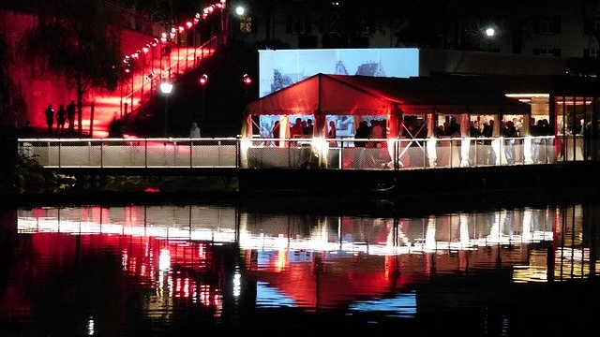
Women Tech Women Yes Summer Gala Engagement
Street Team Placement
Chuck Cao
Chris Chan
Humza Khan
Joshua Mailman

Slide 2
Agenda
Objective
What We Did
Results
Recommendations
Future Work

Slide 3
Objective
Optimize street team placement to gather names and email addresses of those who will attend gala and contribute to cause.

Slide 4
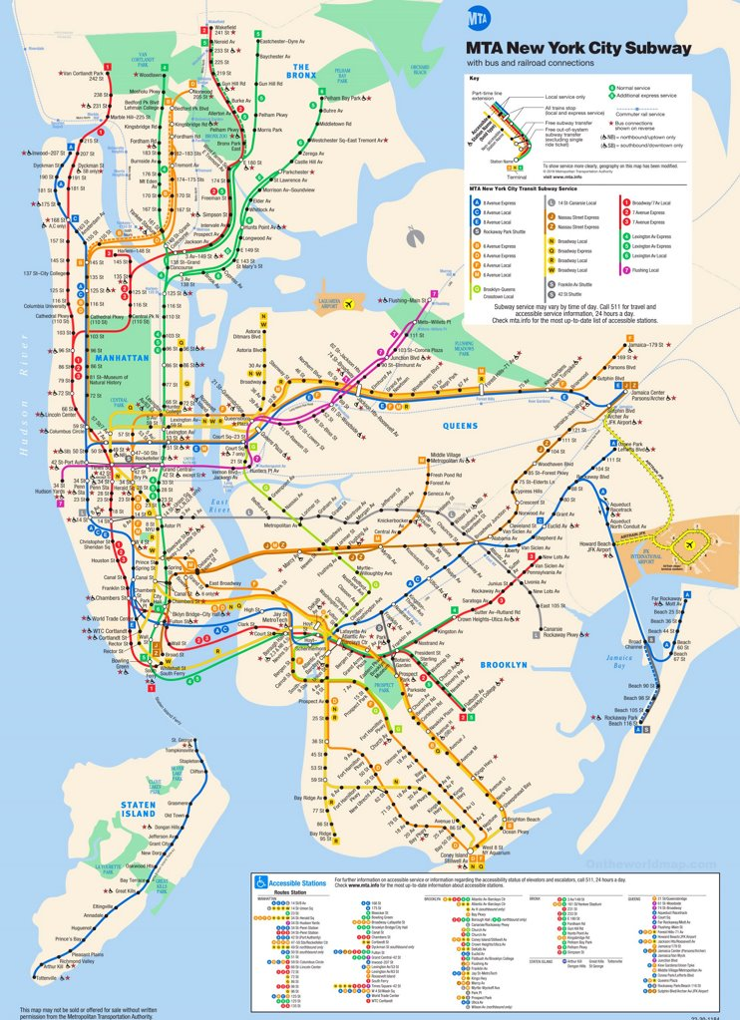
What We Did
Four weeks of July 2019 MTA turnstile data
472 Stations
20.7M NYC metro area residents
Pandas, matplotlib, seaborn

Slide 5
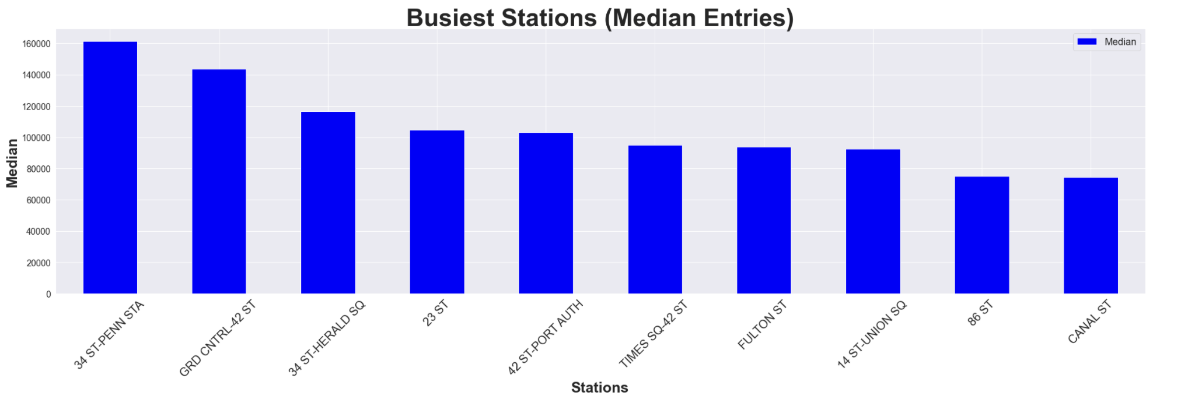


Slide 6
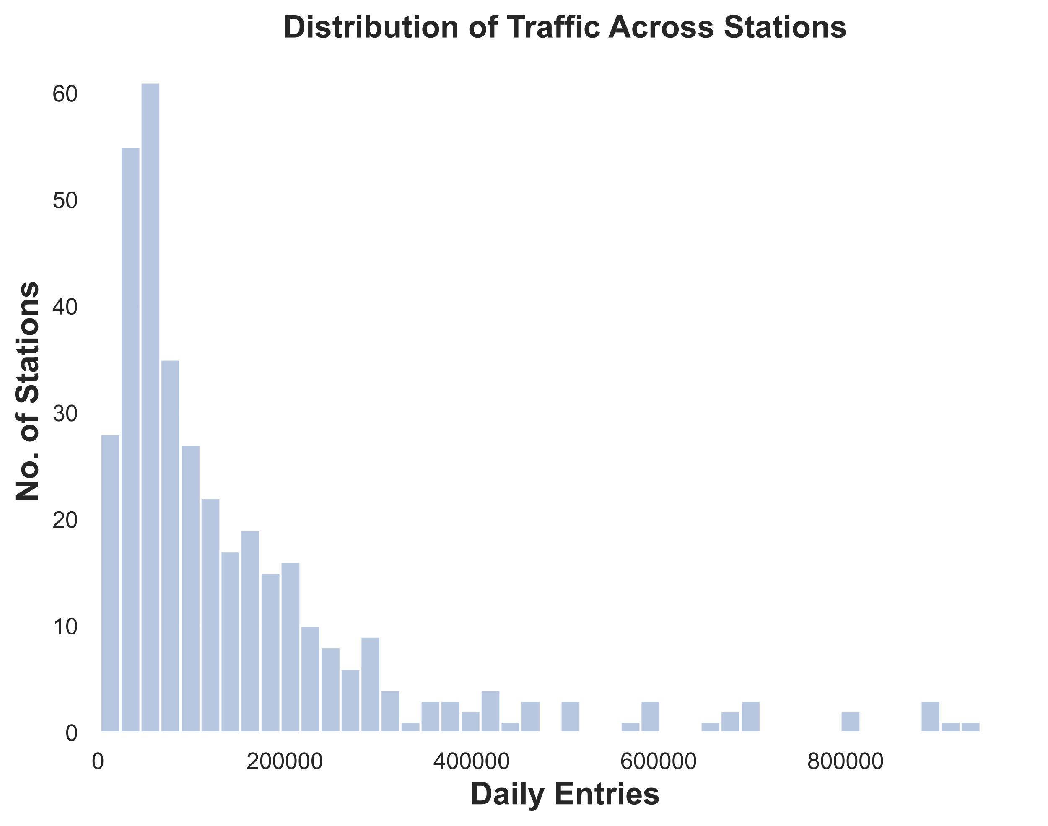

Slide 7
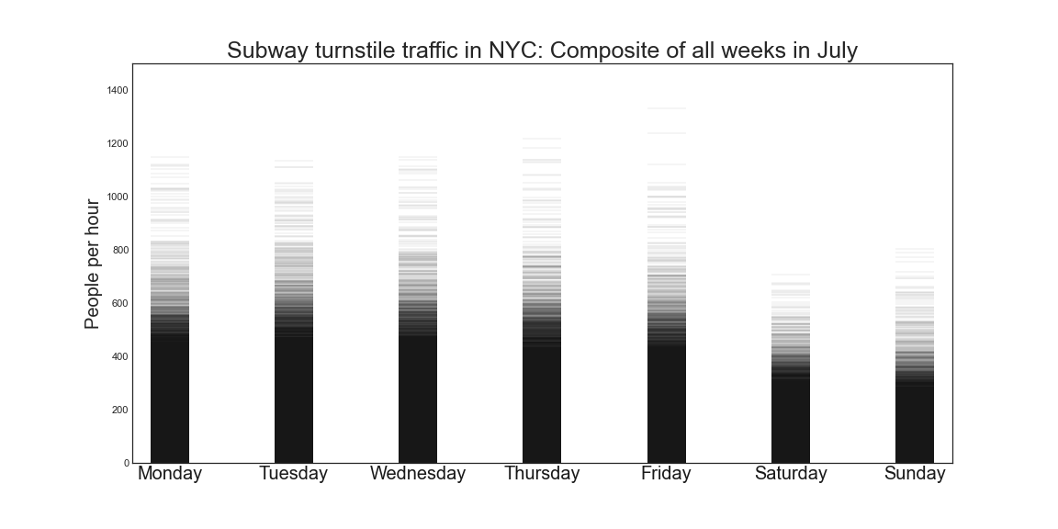
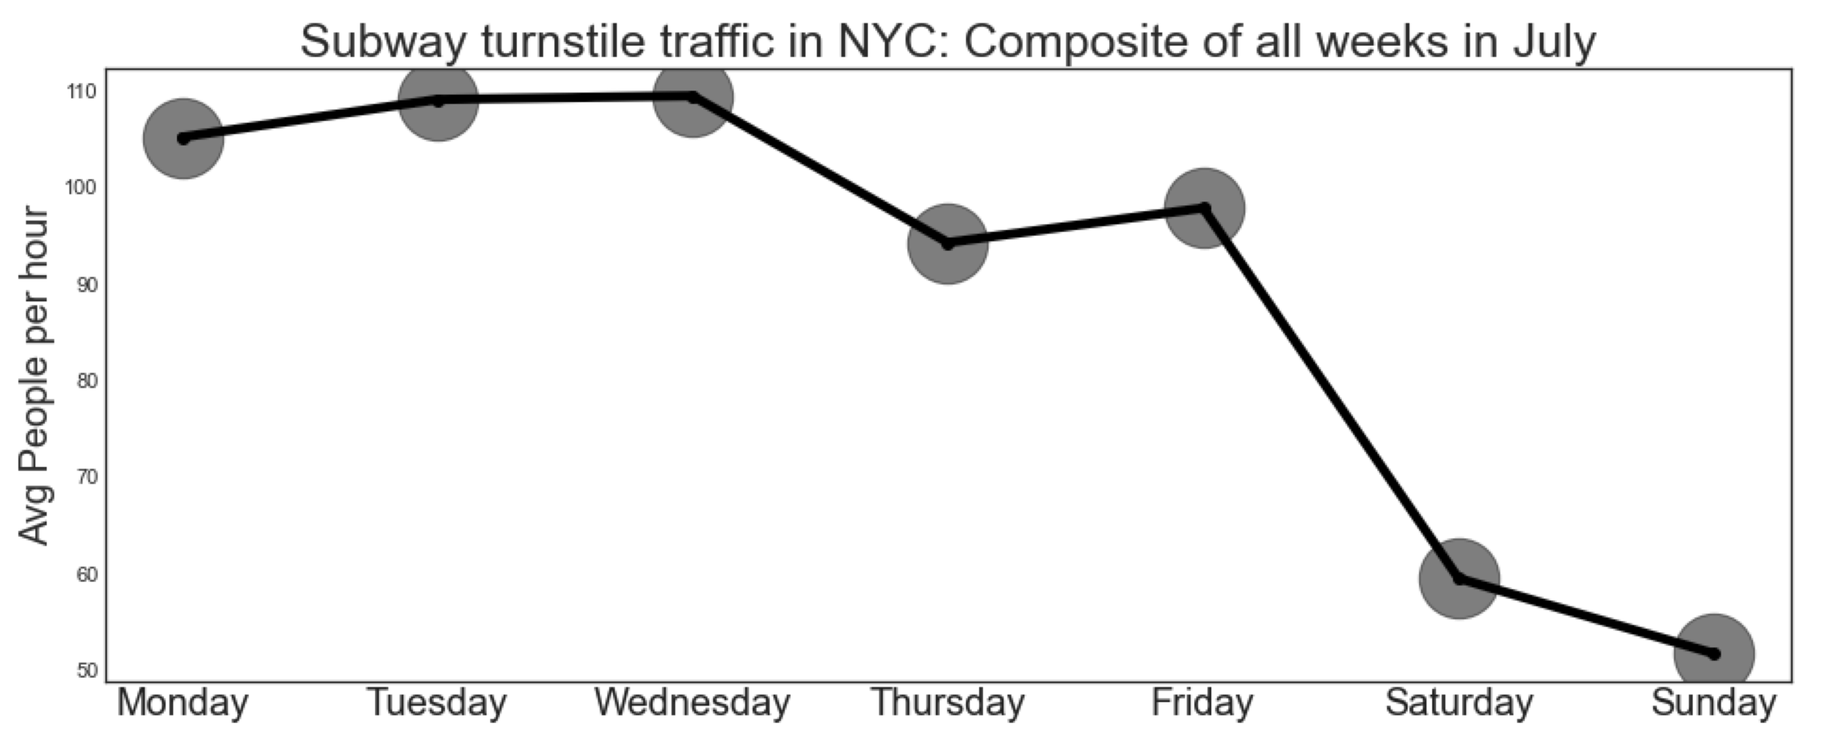
Turnstile Fluctuation By Day

Slide 8
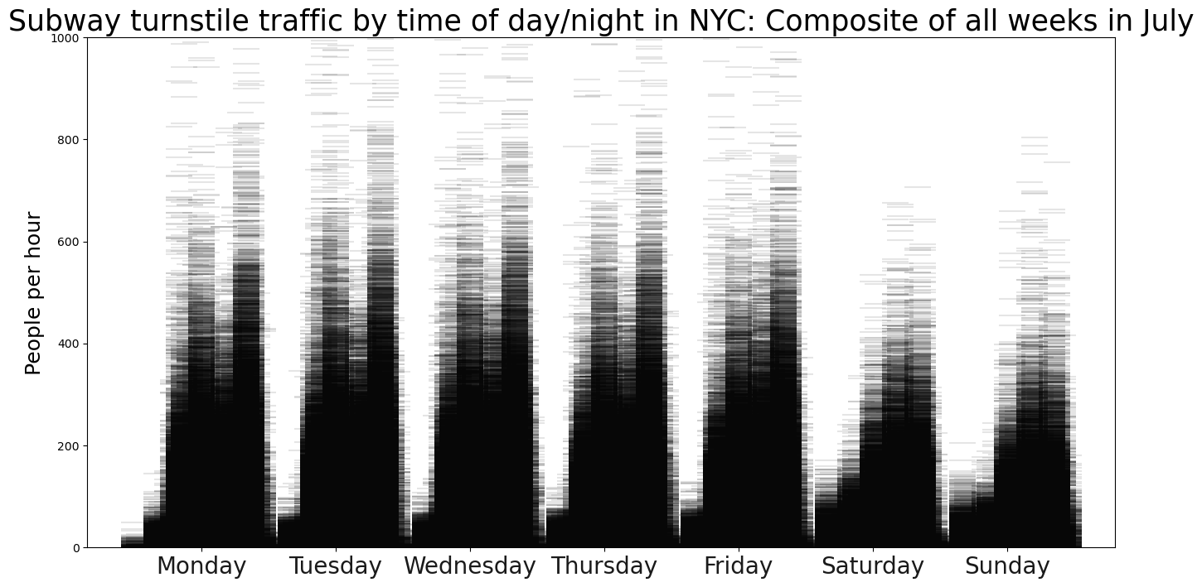
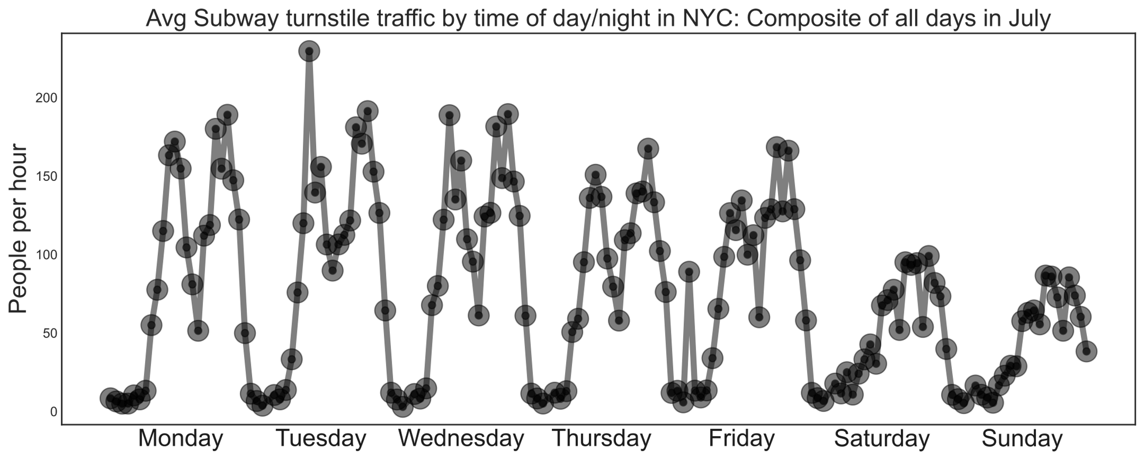
Turnstile Fluctuation By Time During The Week

Slide 9
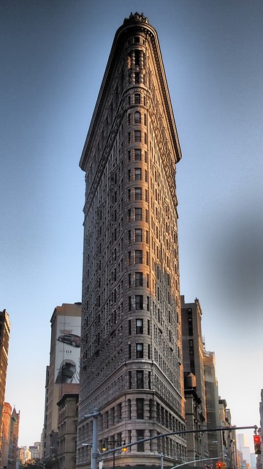
Location, Location, Location
The Flatiron district: NYC’s tech hub

Slide 10
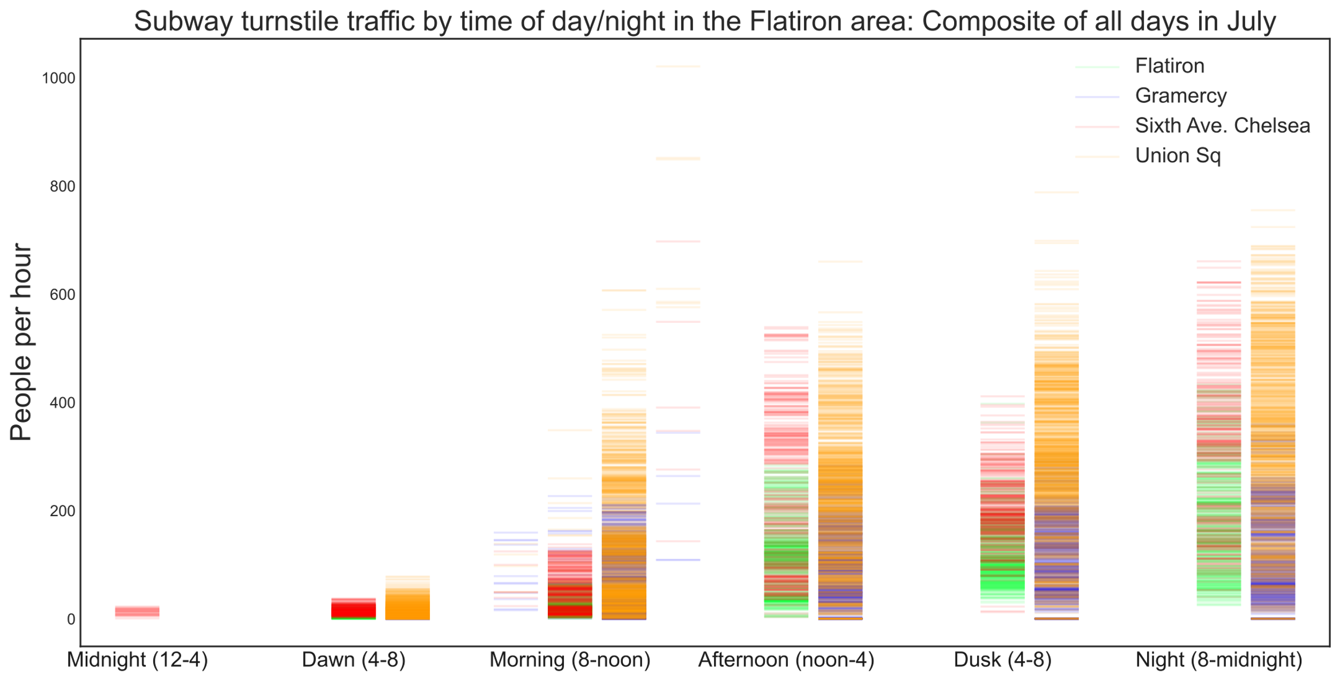
The Flatiron district: NYC’s tech hub
Four subway stops in the area

Slide 11
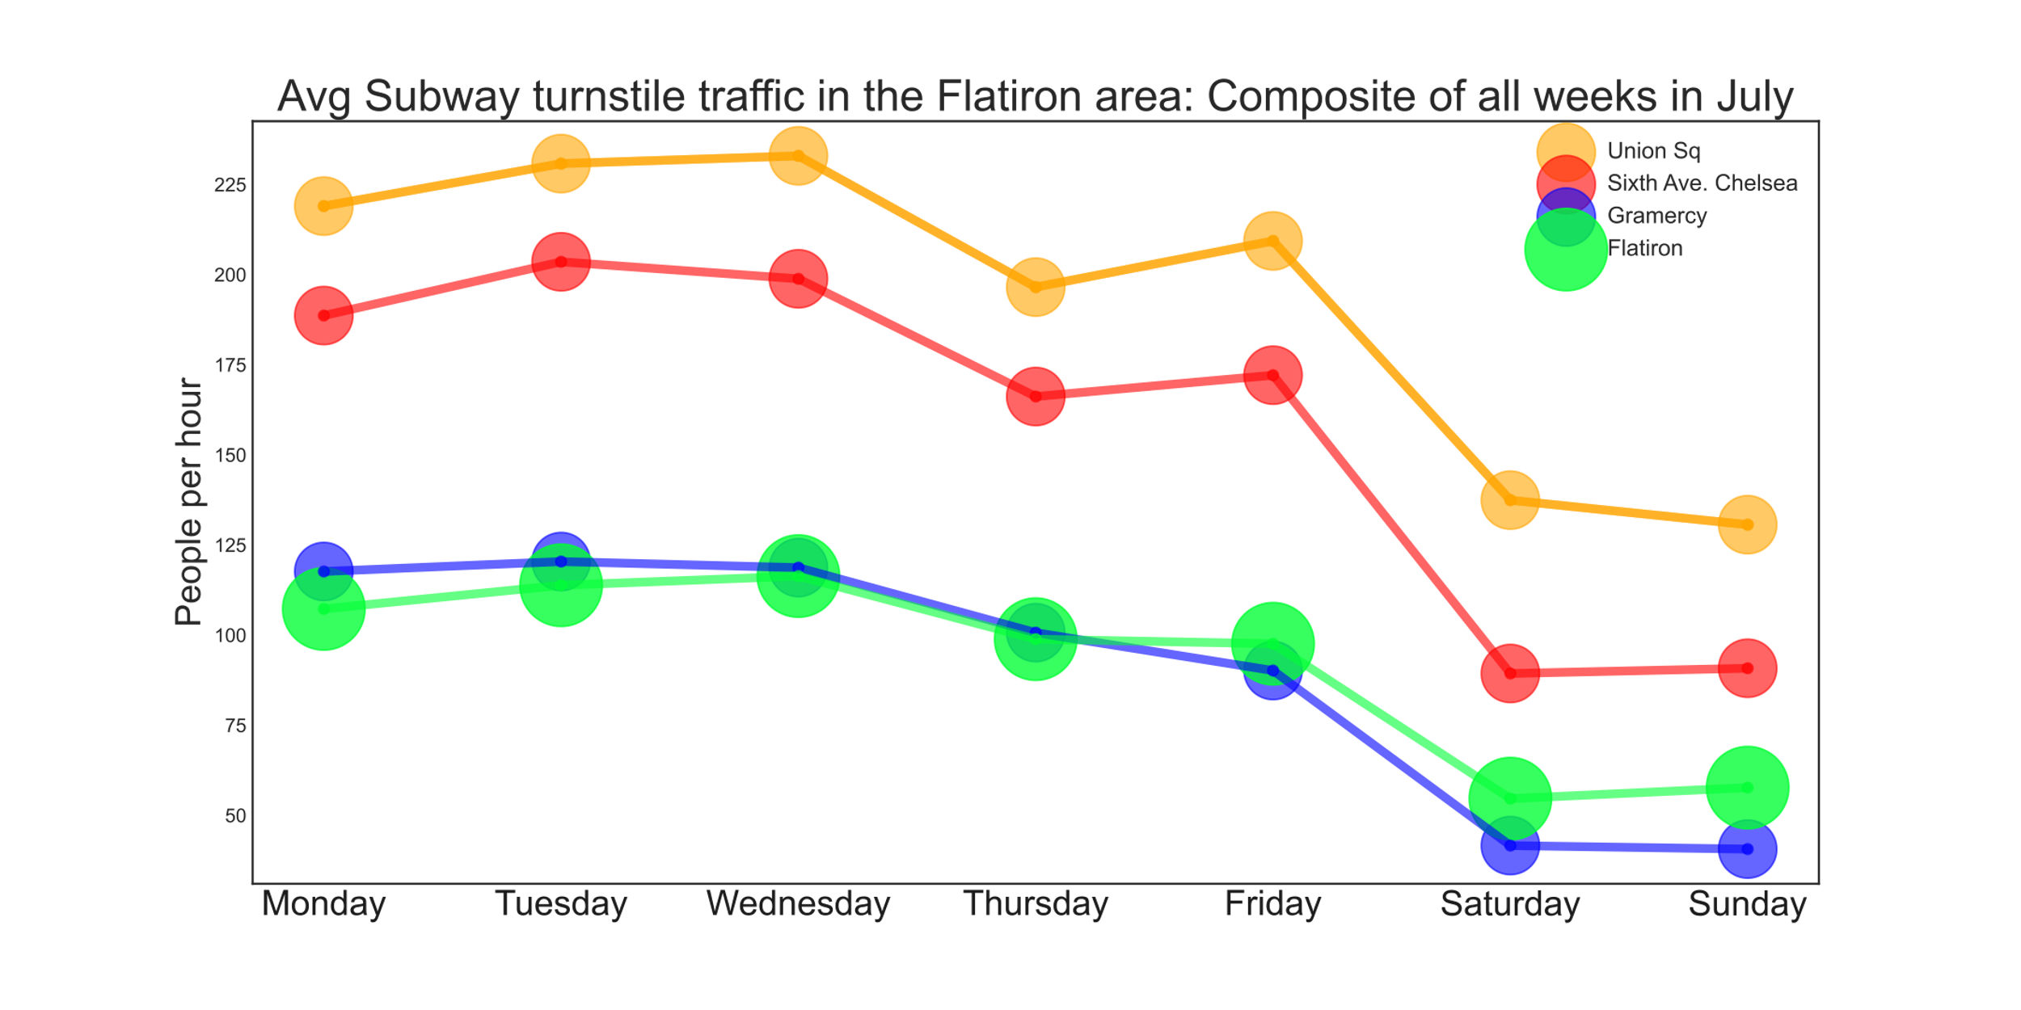
The Flatiron district: NYC’s tech hub
Four subway stops in the area

Slide 12
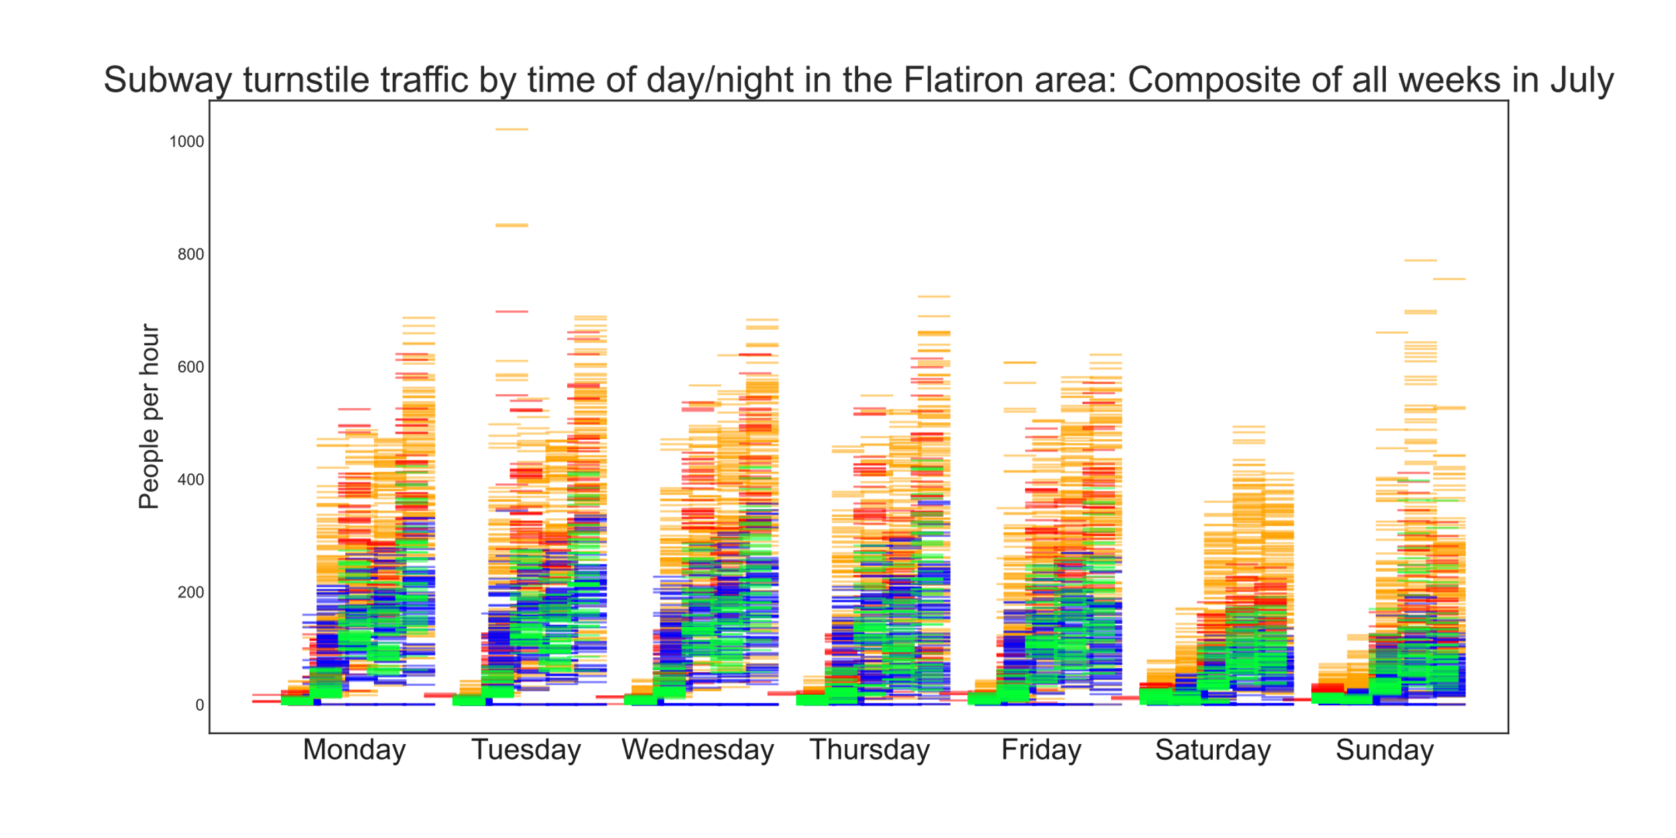
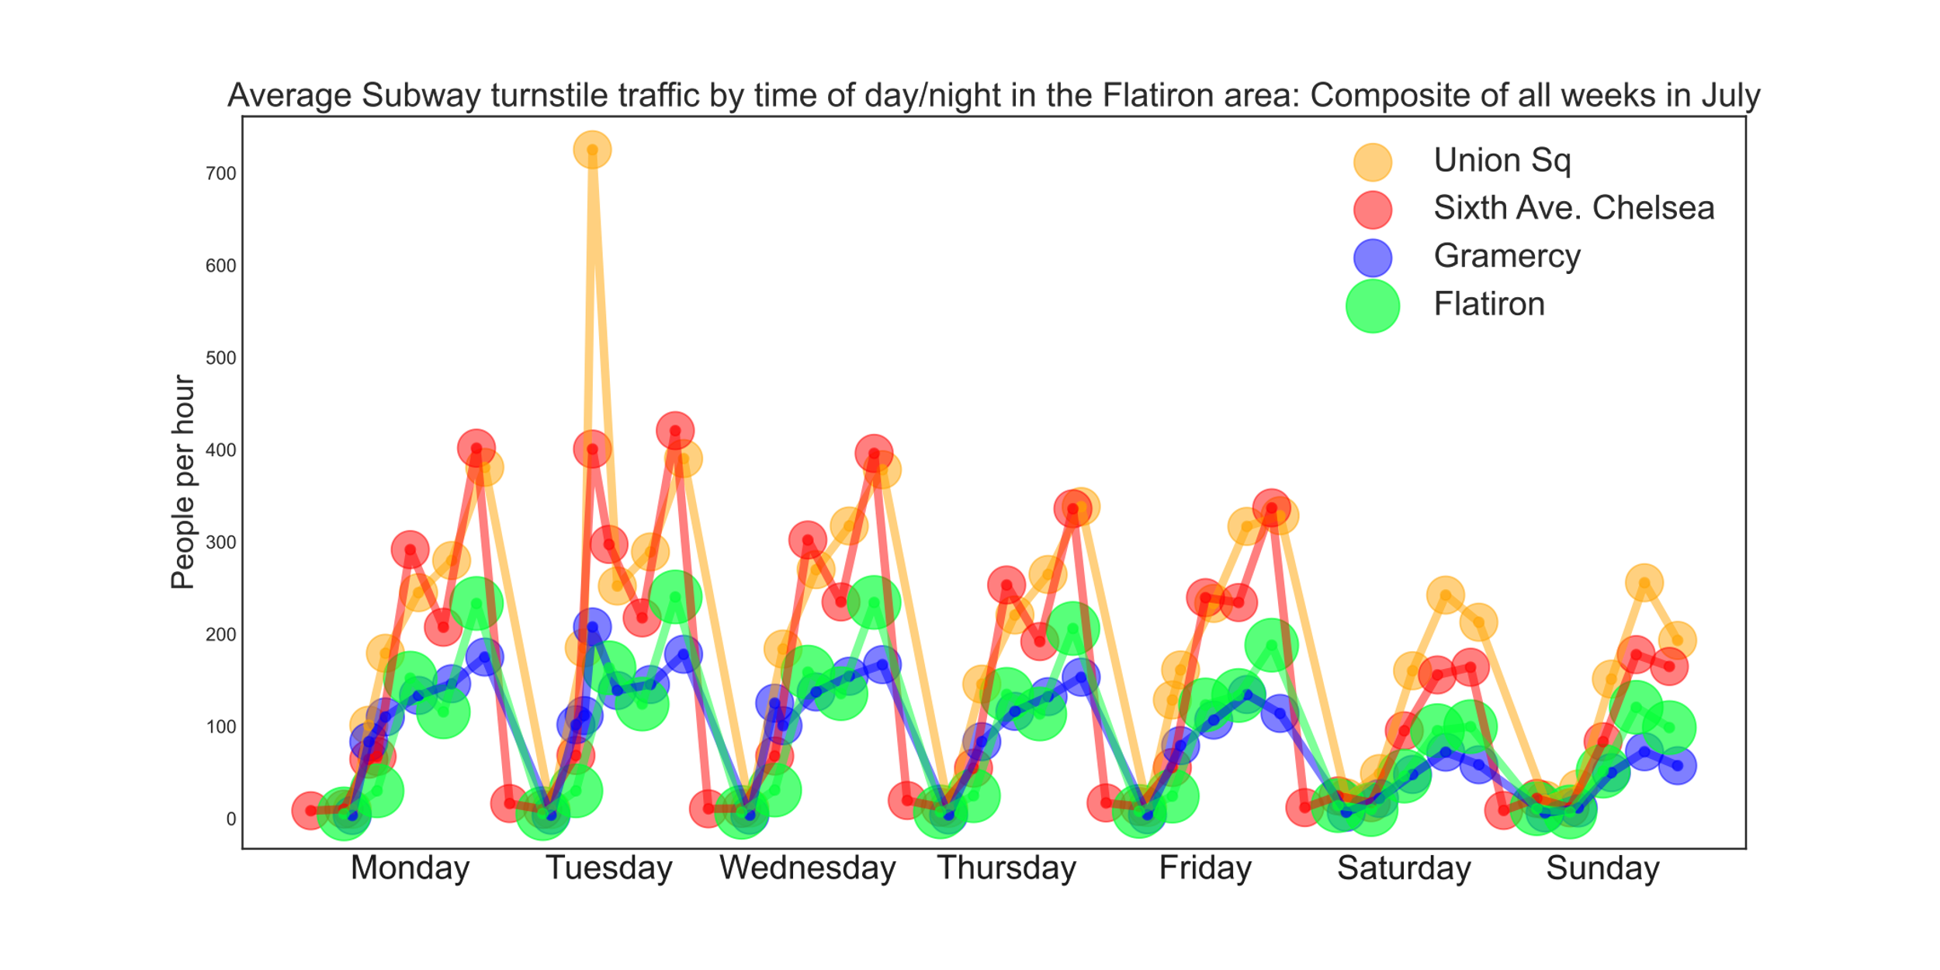
The Flatiron district: NYC’s tech hub
Four subway stops in the area

Slide 13
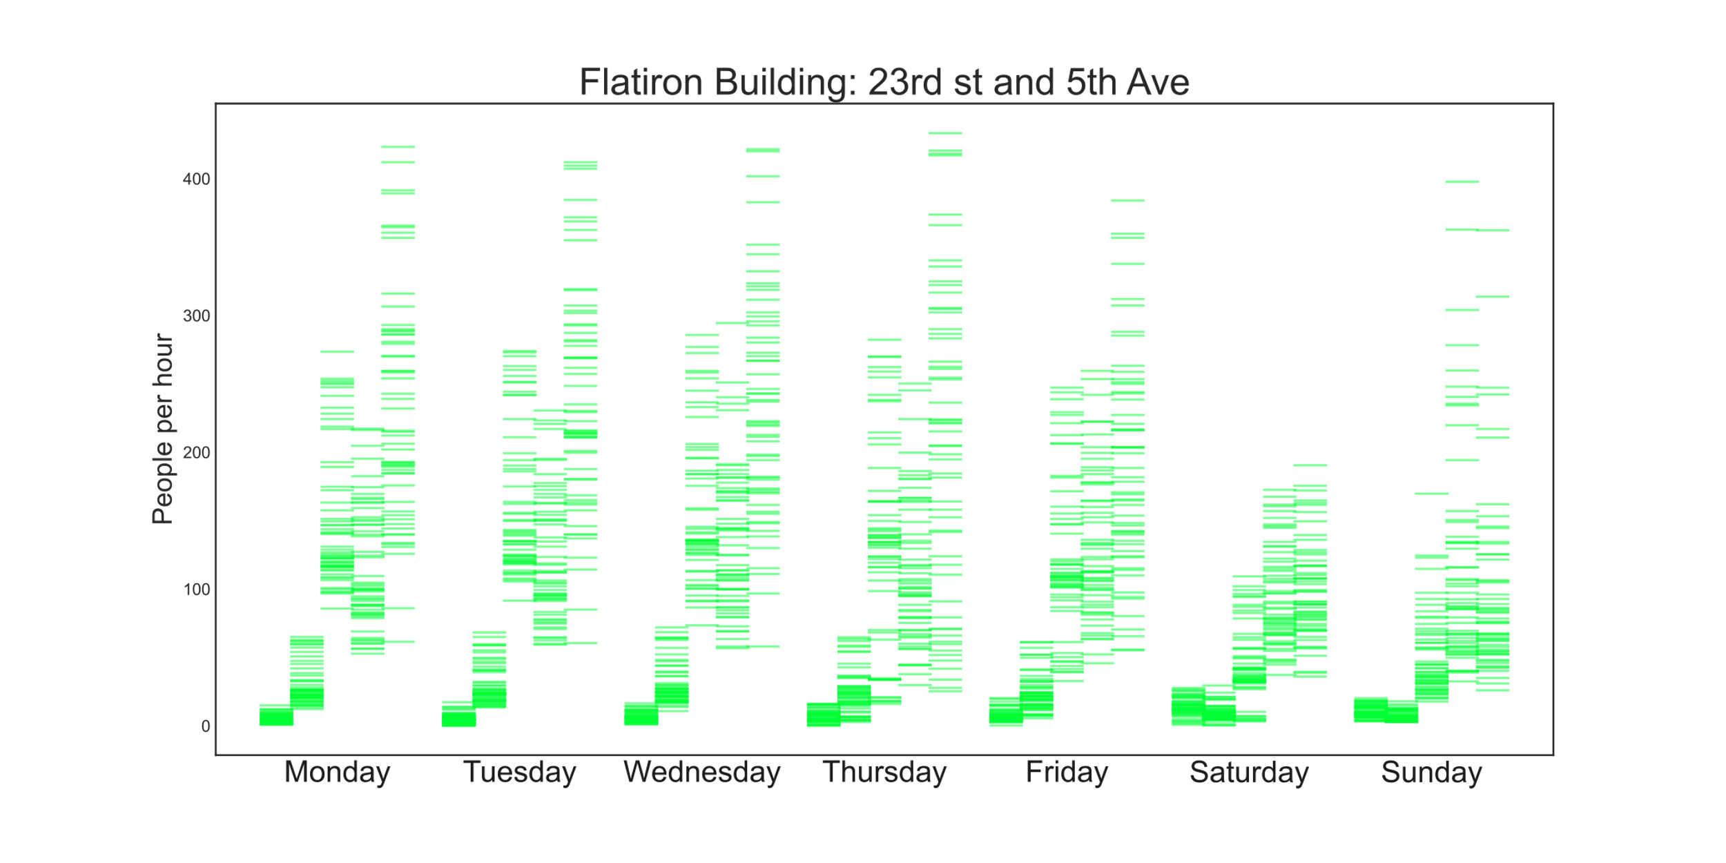
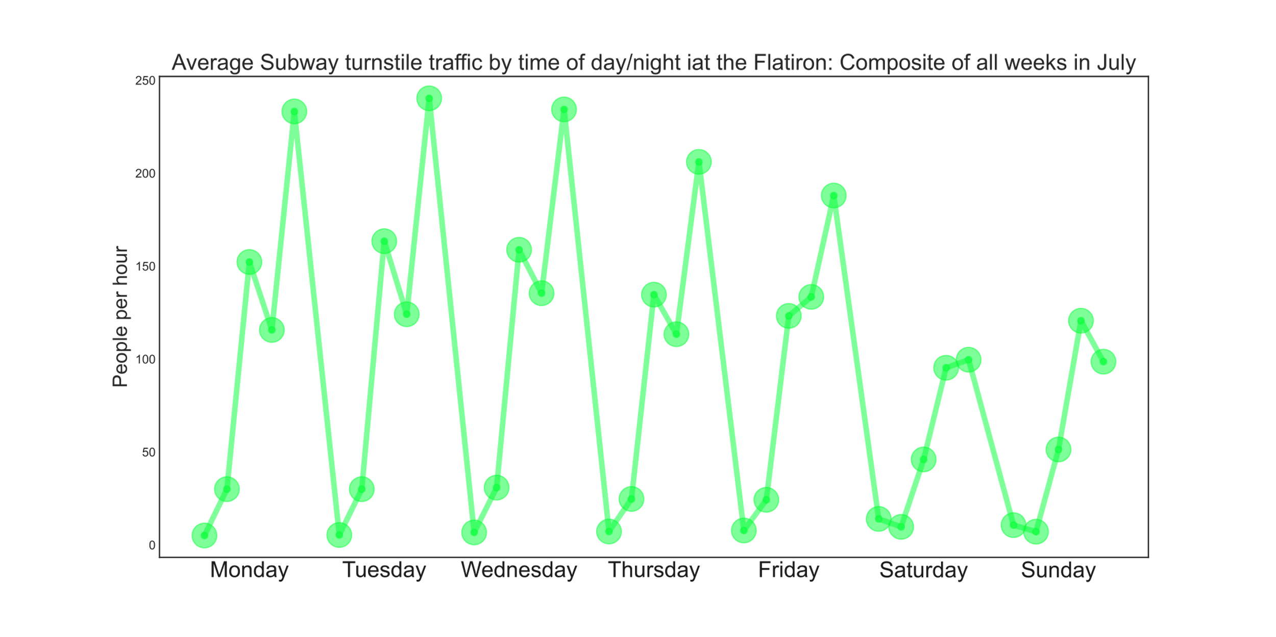
The Flatiron district: NYC’s tech hub
The Flatiron building subway stop: 23rd and 5th Ave

Slide 14
First Recommendation
The Flatiron building subway stop: 23rd and 5th Ave
Flatiron, 23rd st at Broadway and 5th Ave
8pm to midnight , Monday, Tuesday, Wednesday

Slide 15
Location, Location, Location
High-income neighborhoods

Slide 16
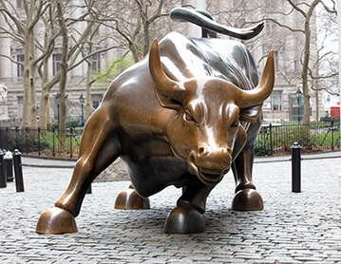
Show me the Money!
Top 10 Subway Stations by Household Income
Top 10 Subway Stations by Household Income

Slide 17
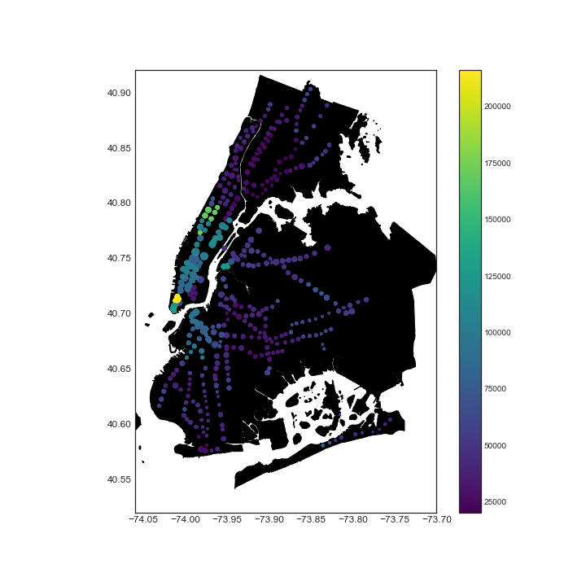
Median Household Income by NYC Subway Locations

Slide 18
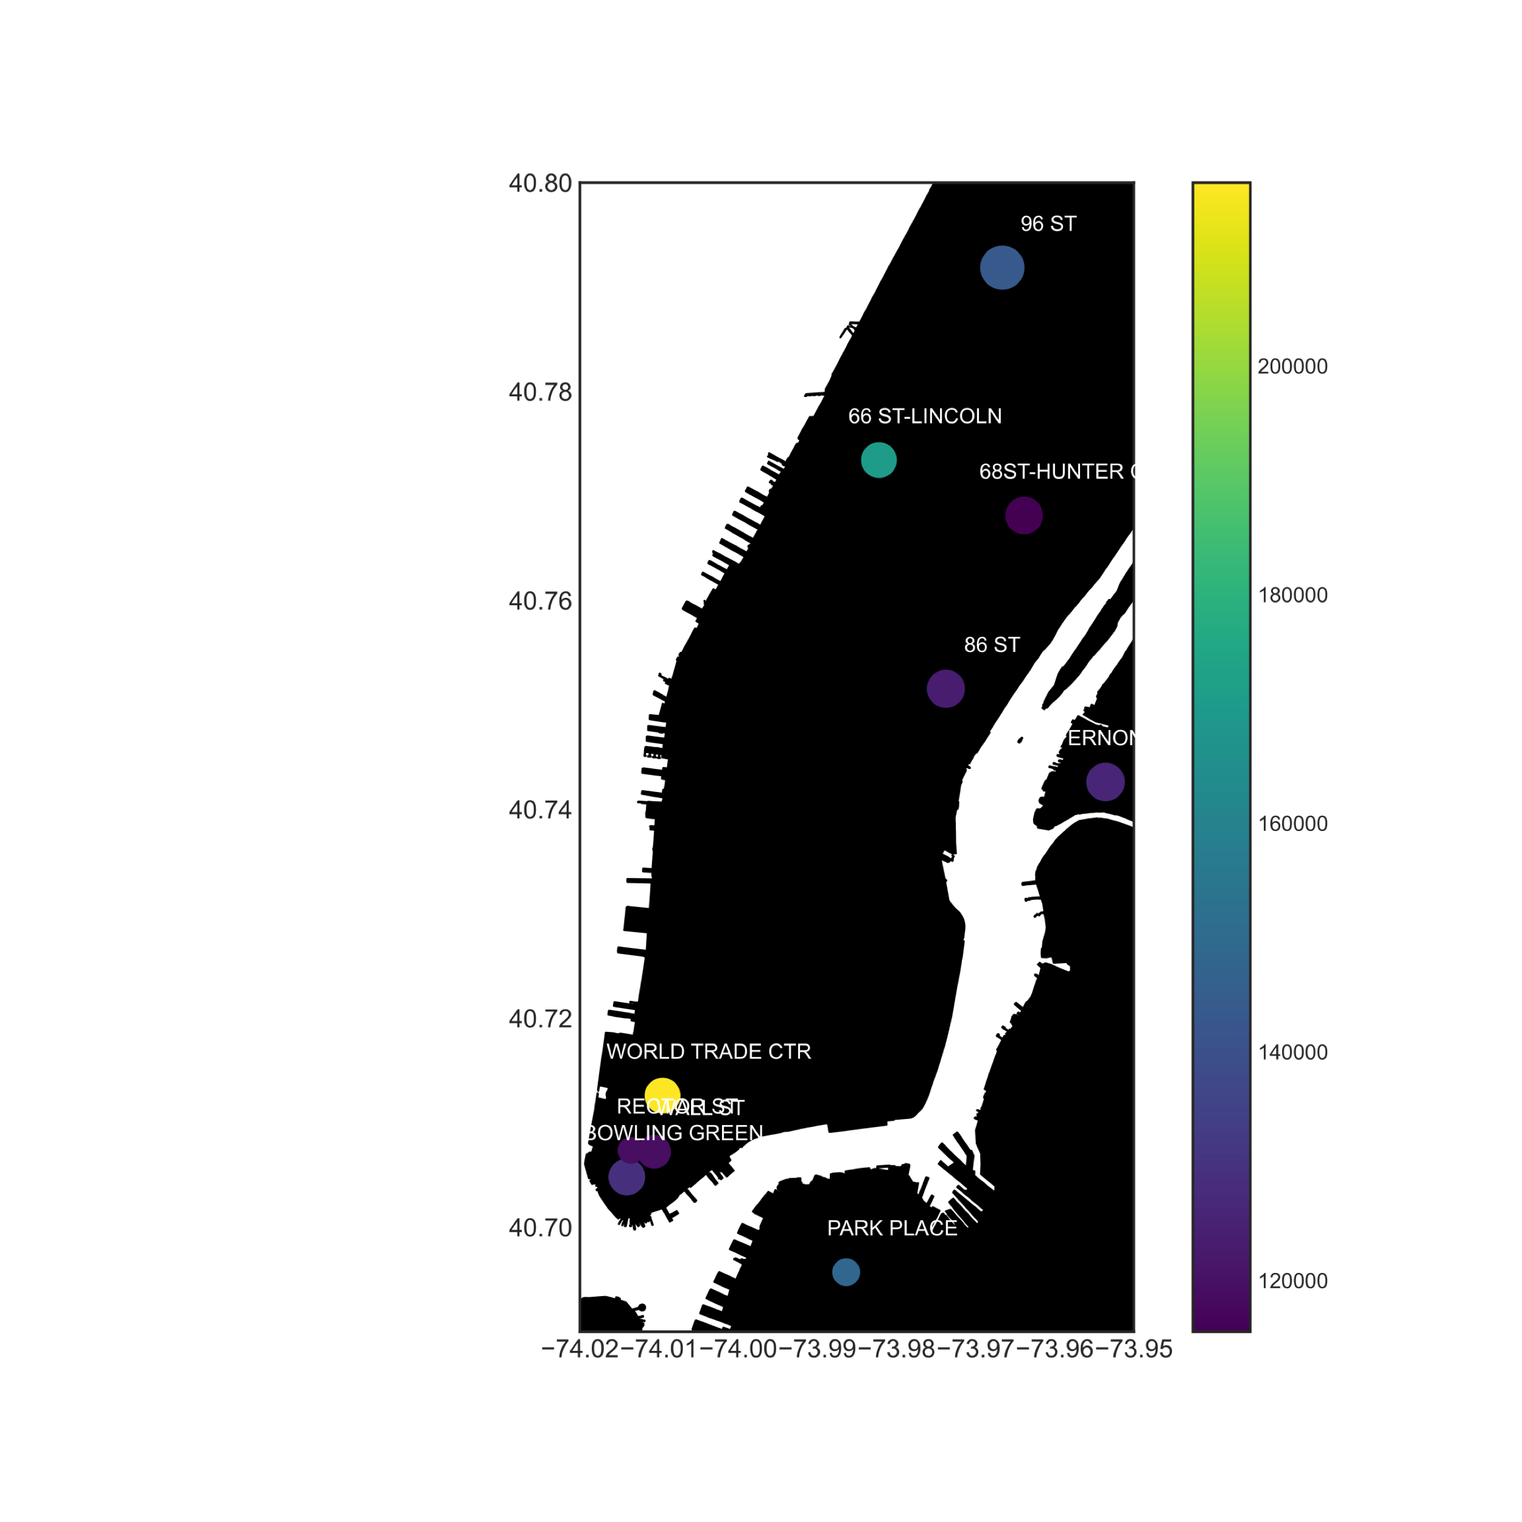
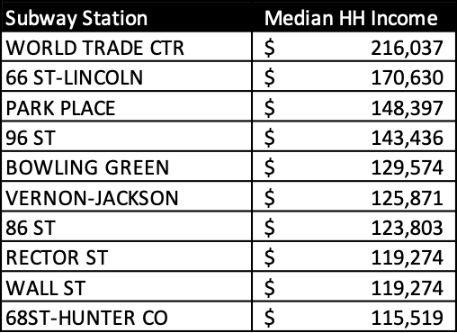
Top 10 Subway Stations by Household Income
Top 3

Slide 19
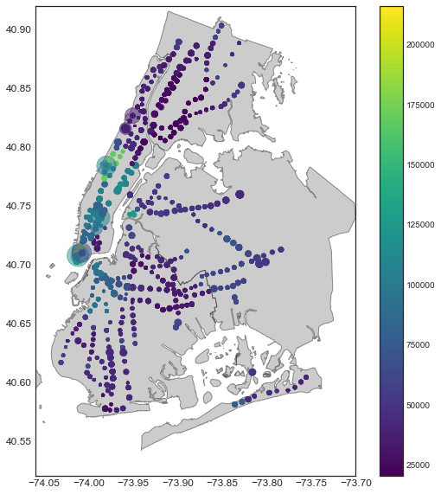
Location, Location, Location
Pursuing a second recommendation,
by focusing on high-income neighborhoods

Slide 20
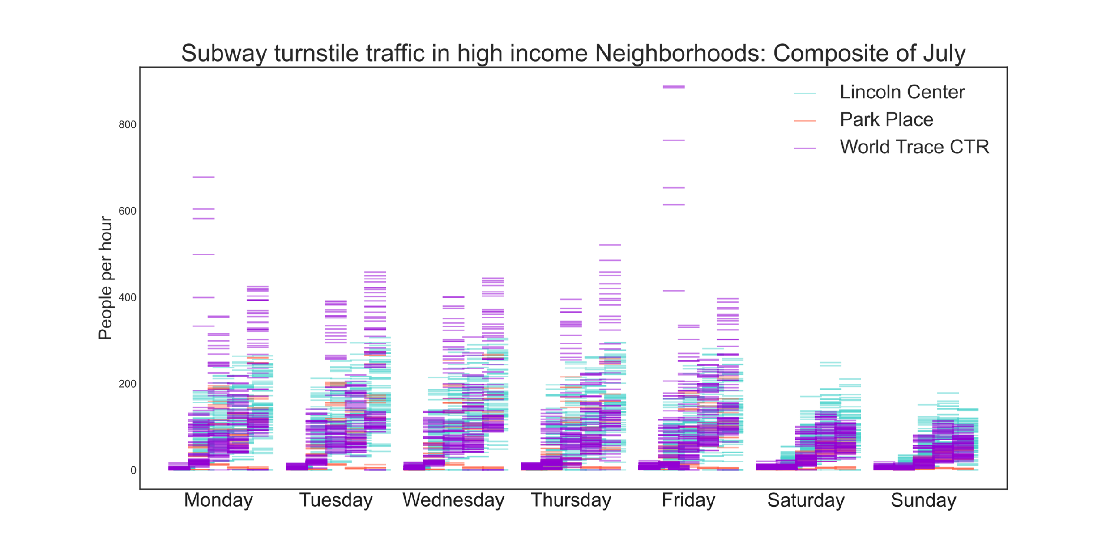
High-income neighborhoods
• World Trade CTR
• Lincoln Center
• Park Place
Choose any from among these

Slide 21
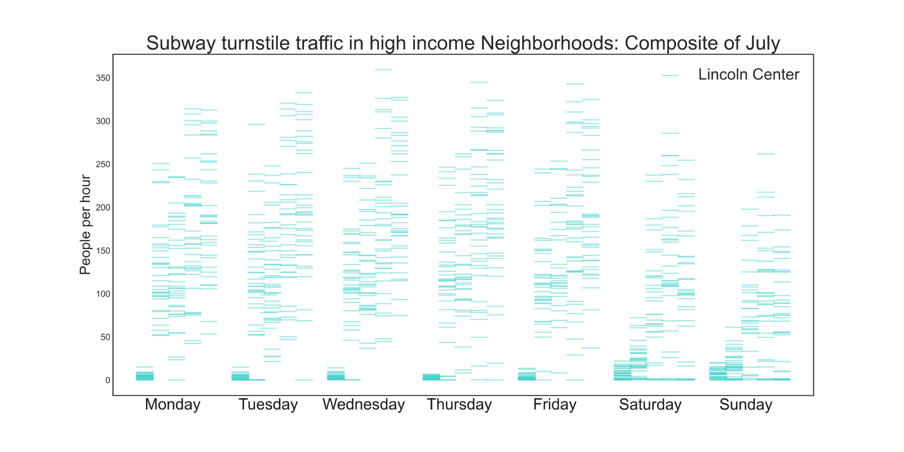
High-income neighborhoods:
• World Trade CTR
• Lincoln Center
• Park Place

Slide 22
Second Recommendation
The subway stop: 66th Street and Broadway, Lincoln Center
Lincoln Center
12 noon to midnight , Monday through Thursday

Slide 23
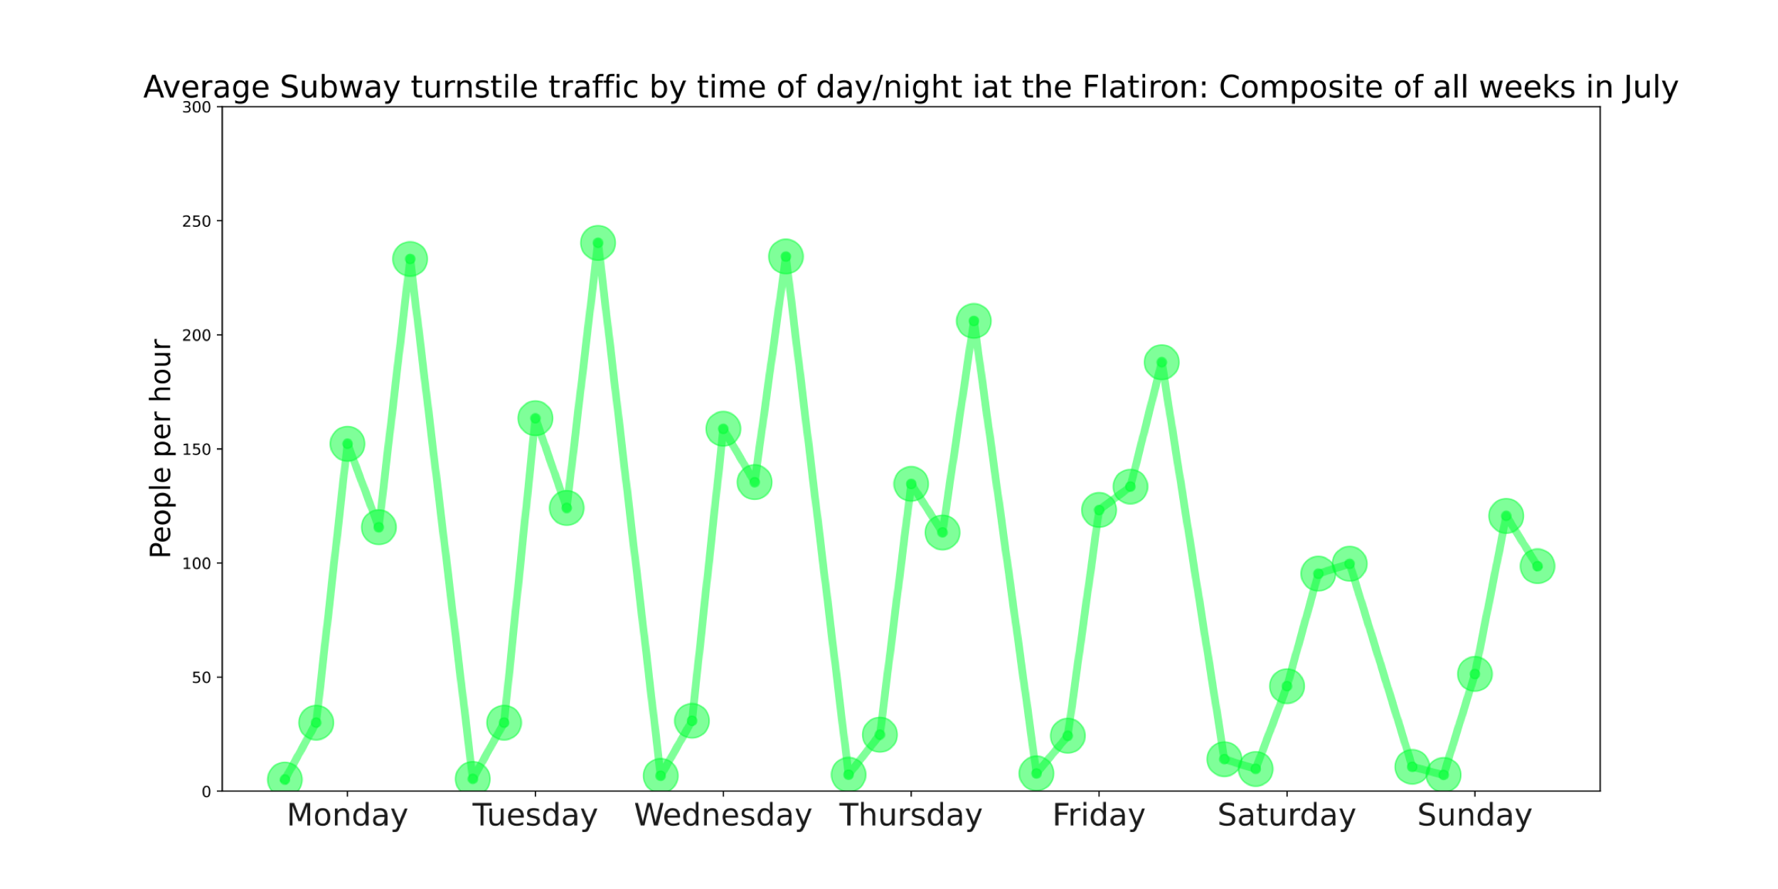
Summary
8pm to midnight ,
Monday,
Tuesday, Wednesday
Flatiron
And possibly the other three subway stops in the area:
• Gramercy
• 23rd st. and 6th Ave
• Union Square
12 noon to midnight,
Monday through Thursday
Lincoln Center
Or
• World Trade CTR
• Park Place

Slide 24
APPENDIX

Slide 25
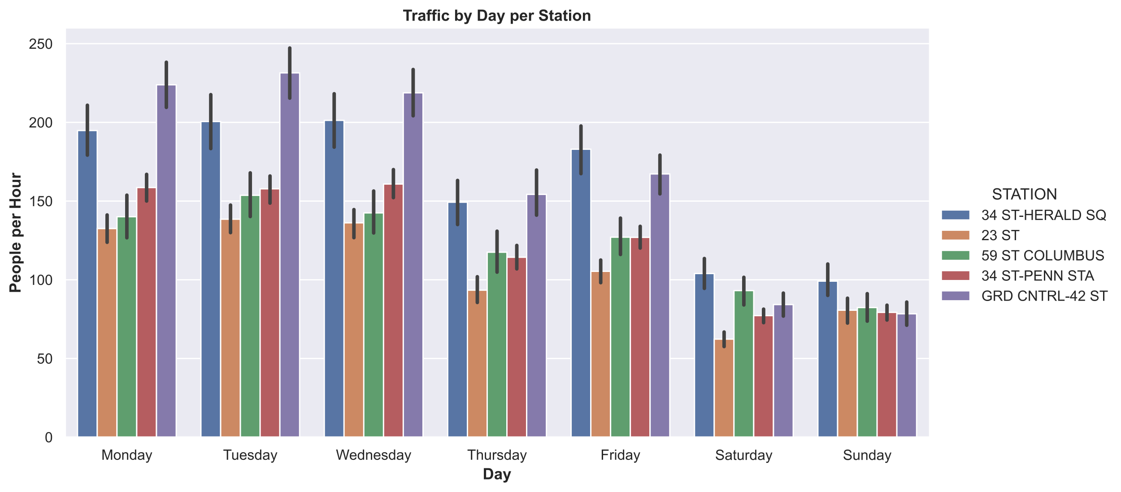

Slide 26
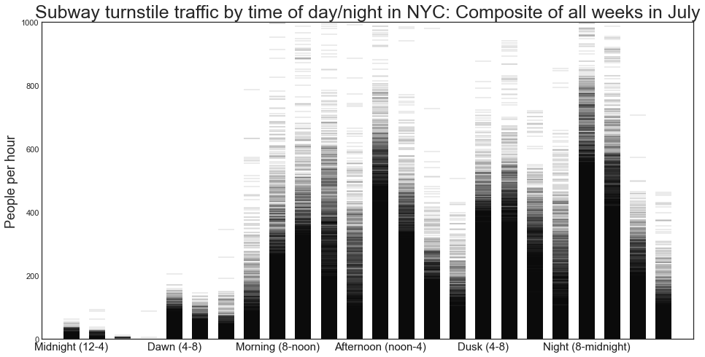
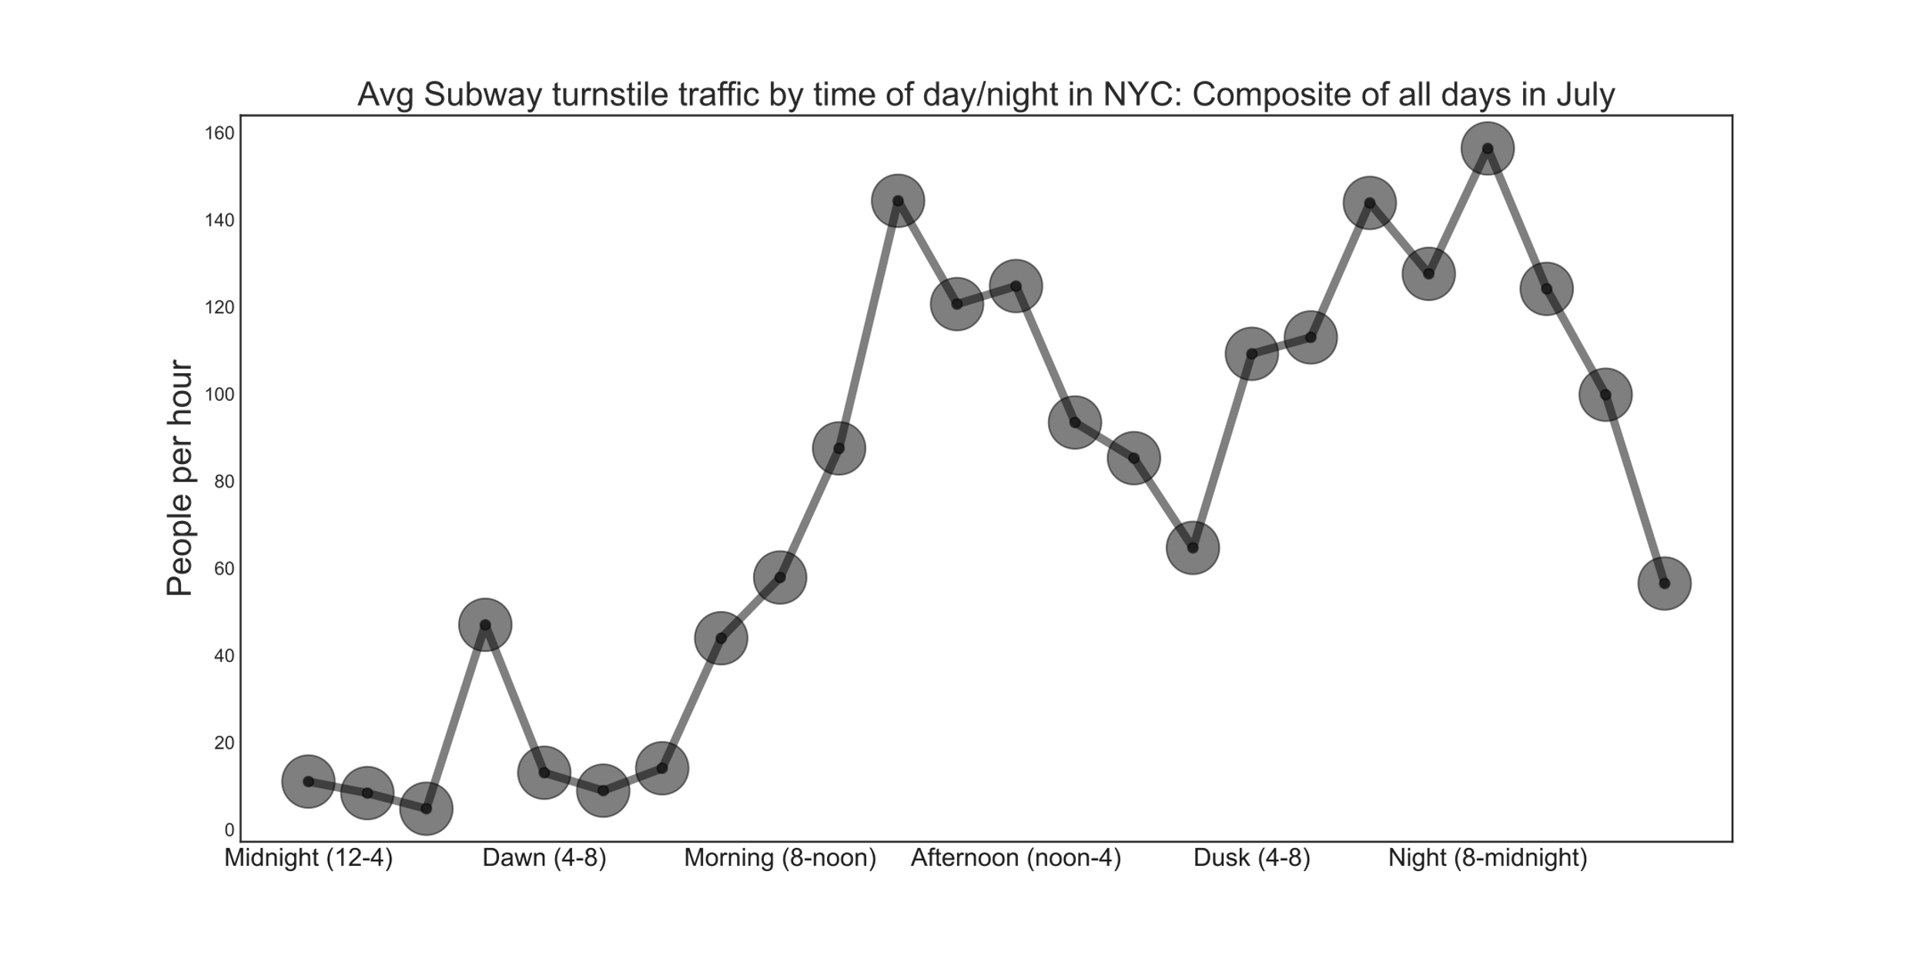
Turnstile Fluctuation By Time of Day

